Slide 1
Connection Guide
Table of Contents
(2) – Connecting tablet to ShopNetwork
(6) – Connecting Time-Track to Database
(8) – Connection Reset/TroubleShoot

Slide 2
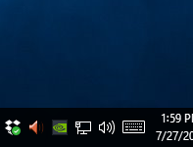
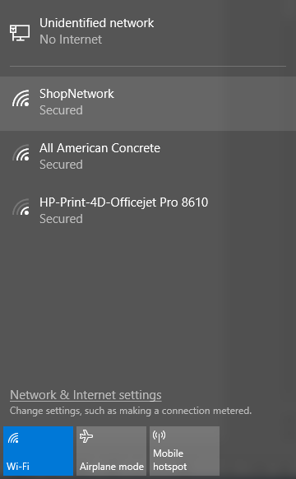
Step 1:
Left click on the network icon in the bottom right hand side of the screen
This window will pop up. Left click the ShopNetwork button, and then click the ‘Connect’ button that will appear.

Slide 3
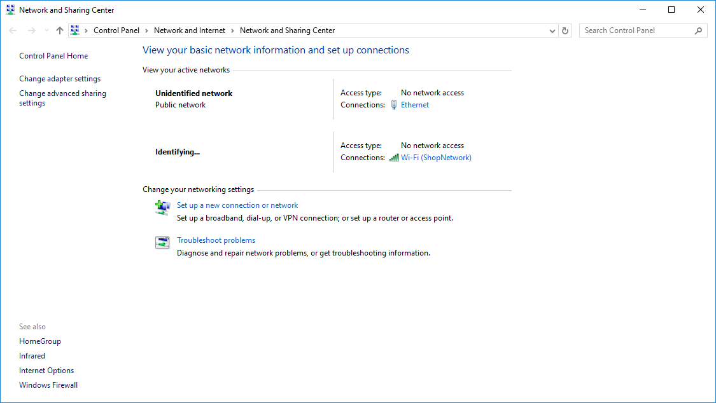
Step 2:
Right click on the network icon in the bottom right hand side of the screen
Of the two options select ‘Open Network and Sharing Center.’
Something like this will open
Left click near the middle of the screen where is says ‘Wi-Fi(ShopNetwork)

Slide 4
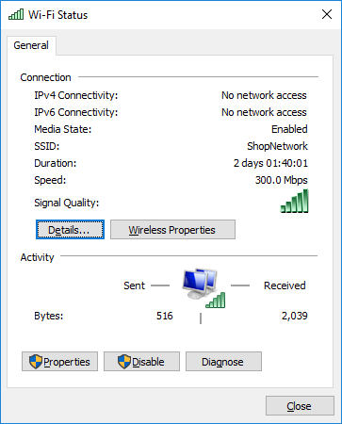
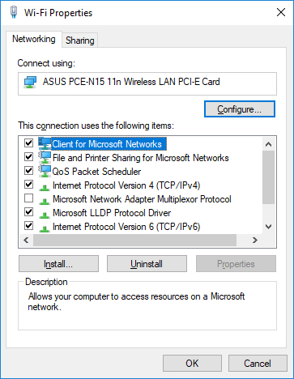
Step 3:
That will bring up a window called ‘Wi-Fi Status’
Left click ‘Properties’
That will bring up a window called ‘Wi-Fi Properties’
Left Click ‘Internet Protocol Version 4(TCP/IPv4), and then click ‘Properties’

Slide 5
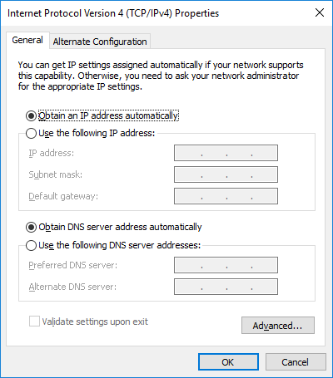
Step 4:
That will bring up a window called ‘Internet Protocol Version 4 (TCP/IPv4) Properties’
Click on the radio button called ‘Use the following IP address:’
‘IP address:’ should be 192.168.0.145
‘Subnet mask:’ should be 255.255.255.0
Press ‘Ok’, ‘Ok’, ‘Close’ to close all of those windows and then go to the next slide to connect to the database.
Note the last three digit of ‘IP address’ can be 145-150 for sure(I have tested those). Just make sure that each tablet gets its own number!

Slide 6
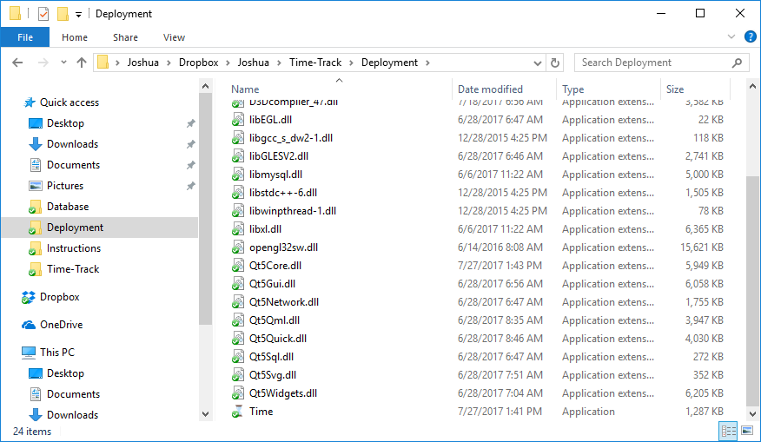
Step 5:
Go to DropBox > Joshua > Time-Track > Deployment
Right click on ‘Time.exe’ and ‘Pin to Taskbar’

Slide 7
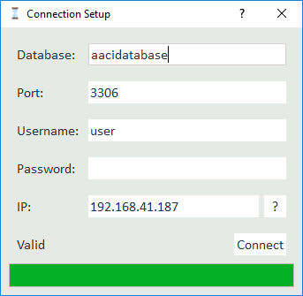
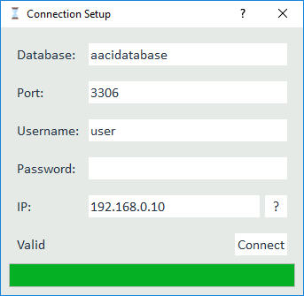
Step 6:
Click on the icon on you taskbar
To connect from the office choose the IP shown below
To connect from the office choose the IP shown below
Then press the ‘?’ to validate the connection
And press ‘Connect’ to start Time-Track

Slide 8
Step 7:
If you are ever having connection problems go to This PC > Documents and delete the folder called ‘Time-Track’
Then just retry and fill in the appropriate info and you should be good to go!

